Slide 1
PRIVACY | WHAT IS CHANGING?
Presenters and panel members
Pieter van der Walt Carlia van der Merwe
Dirontsho Mohale Clinton Ricardo Williams
Kezia Talbot Verena Altendorfer

Slide 2
Reasons to care about privacy
Your customer
Doing the right thing
In a world where information is commoditised, privacy is a fundamental human right. Without it, freedom and livelihoods are under threat. We would not wish this on anyone, so act as trustworthy custodians of clients’ privacy, as we would our own.
Financial advisers are part of a profession that requires advanced and ongoing learning. A set of ethical values and legal principles underpin and guide our work. We do the right thing and ensure that every interaction meets the highest ethical standards.
Notes:
Positioning slide – remove values
Upcoming regulation, all bound, this is how we are impacted as a human, as a client as a broker etc.
Reword the values – Customer being central
Ethical thing – Doing the right thing

Slide 3
INTRODUCTION
Pieter van der Walt

Slide 4
What is different now that POPIA is in place?
SPECIAL PERSONAL INFORMATION
RESPONSIBLE PARTY
MINIMISE
New responsibilities defined under the act
Collect only what you need
Extra protection for
special personal information and children
SECURITY AND STORAGE
DIRECT MARKETING
TRANSBORDER
Reasonable measures to protect information and data to be deleted when no longer required
Consent required
Send to only where personal information is protected
REGULATORY ENVIRONMENT
ENFORCEMENT AND RIGHTS
OPENNESS
Single regulator with enhanced oversight
Legal consequences in case of breach and enhanced rights to individuals
Clearly defined reason provided to clients for collecting information
CULTURE OF PRIVACY AND TRUST

Slide 5
What is personal information?
ANY INFORMATION RELATING TO AN INDENTIFIABLE LIVING NATURAL PERSON OR AN EXISTING JURISTIC PERSON
PERSONAL INFORMATION
SPECIAL PERSONAL INFORMATION
Email address
Physical address, location information
Telephone number
ID number
Membership number
Age
Physical or mental health
Ownership information (for example cars, houses and possessions)
Job title
Employment history, education or financial
Family structure
Personal opinions, views or preferences
etc
Race or ethnic origin
Gender identity
Sexual orientation
Health (for example HIV status)
Criminal behaviour and history
Religious beliefs
Philosophical beliefs
Trade union membership
Any information related to children (< 18)

Slide 6
COMPLIANCE REQUIREMENTS
Dirontsho Mohale

Slide 7
Minimum mandatory requirements
Appointment, registration and training of an information officer
Forms in guidelines
Webinars
Develop, implement, maintain and monitor a compliance framework
Impact analysis
Privacy Statement
POPIA compliant Promotion of Access to Information (PAIA) manual published
Data subject rights
Document and implement process
Forms in Regulations
Conduct personal information impact assessments
New products and initiatives
Enter into operator agreements
Contract review to include compliance with POPIA
Security safeguards
Ensure systems cannot be hacked
Email personal information as an attachment which is password protected
Scan all hardcopies containing personal information
Notes:
appointment and registration of an information officer and, if necessary, deputy information officers and registration
If PO is IO, mandate must be amended and addendum thereto drafted and signed and then submit registration to IR

Slide 8
PRACTICAL CONSIDERATIONS
Carlia van der Merwe and Kezia Talbot

Slide 9
Consider the information lifecycle
Acquire
Use
Share
Maintain
Destruction
Collection for purpose identified
Information sources
Identification and verification
Integrity and accuracy of information
Responsibility and accountability
Explicitly defined consent
Monitor data use
Breach management
Necessity
Notification
Internet and email
Clean desk
Sharing channels
Unprotected and sensitive or confidential information
Consent
Audit trails
Due diligence
Appropriate storage
Storage medium
Contingency plans
Access restrictions
Integrity and accuracy of information
Policies
Retention periods
Shredding and disposal
De-identification or destruction
Data removal and verification of removal
Render data anonymous
Notes:
Find a way to demonstrate through examples, either through presenter or inclusion in the slide

Slide 10
Changes in how we acquire data
LEADS
Acquire
Use
Share
Maintain
What you need to think about
POPIA requires that leads must be acquired from leads providers that follows the proper process in obtaining the information.
Who is your leads provider?
Do you subscribe to Direct Marketing Association of South Africa (DMASA)?
Do you have a contract in place including the obligations of the leads provider in terms of POPIA?
For how long do you rely on the information of a leads list?

Slide 11
Changes in how you use data
CONSENT
Acquire
Use
Share
Maintain
What you need think about
POPIA requires that clients must be able to opt out of marketing.
Do you have a process in place to record client opt outs?
Do you have a script to ask permission for marketing to the client when cold calling?
Notes:
Do these impact on brokers enough to warrant a slide? when Carlia and I met we didn’t consider this as critically impacting them?

Slide 12
Changes in how you share data
Secure your Communication
Acquire
Use
Share
Maintain
What you need to think about
POPIA requires that the sender of personal information must ensure that there are active control measures in place for sharing information in a secure way.
What information do you send out that contains personal information?
Is it necessary to include this information?
What methods are available to you to secure the information (eg PDF encryption, Zip files with password protection or secure links to Dropbox, One drive, etc)?
Which communication methods do you currently use that might not be considered secure (eg WhatsApp)?
Notes:
Think about manual processes as well (paper based)

Slide 13
Changes in how we maintain data
DELETION OF INFORMATION
ACCESS TO INFORMATION
Acquire
Use
Share
Maintain
What do you need to think about
What do you need to think about
POPIA requires that clients must have the right to request that you delete their information.
POPIA requires that clients have the right to ask you what information of theirs you hold and who you have shared this information with.
You have an obligation to make sure data is up to date, complete and not misleading.
Do you have a system to give clients the POPIA Form 2 when they ask you to delete their information?
Do you have a process in place to action these requests?
Do you have a process in place to action these requests?
Do you have a method to ensure that client data is regularly updated?

Slide 14
Day-to-day implications
Other important things to note
Keep your desk clear of documents with personal information
Don’t leave printed documents with personal information in a printer or on your desk
Store hard copies in rooms or cabinets that can lock
Update passwords and software when required
Secure communication (for example PDF encryption) when sending personal information
Triple check:
Recipients before you send an email
Accuracy of data captured on your relevant databases
ALWAYS lock your computer, shut down (and lock up) when done

Slide 15
ADDITIONAL SUPPORT
Verena Altendorfer

Slide 16
Training and support
Resources
Training and support
The Act | www.popia.co.za
Readiness checklist | https://www.lexisnexis.co.za/lexis-digest/legal/d-day-for-popi-act-compliance-looming/checklist
Valuable information | https://www.popiact-compliance.co.za/popia-information/4-popia-implementation-actions
Webinar series
https://www.youtube.com/watch?v=4RAoL1DDDuk
https://www.youtube.com/watch?v=Qjr-t0hyIQY
https://www.youtube.com/watch?v=2_sHUlKQNAo
Remember that your compliance officer should be your support through this process.
Notes:
Not applicable for this FIA audience.

Slide 17
Training and support
The Act
Notes:
Not applicable for this FIA audience.

Slide 18
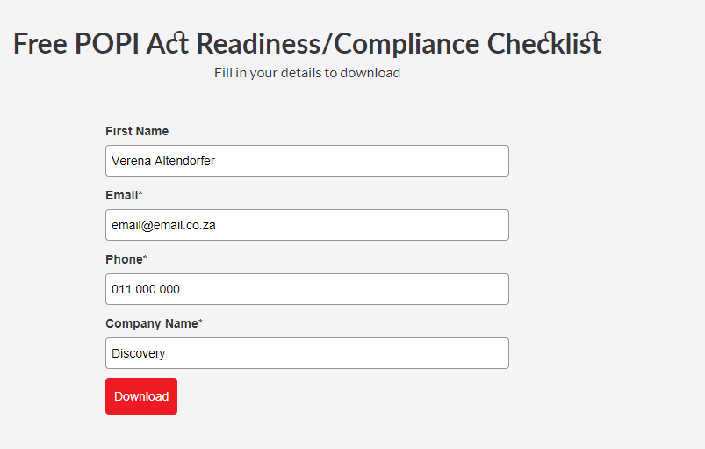
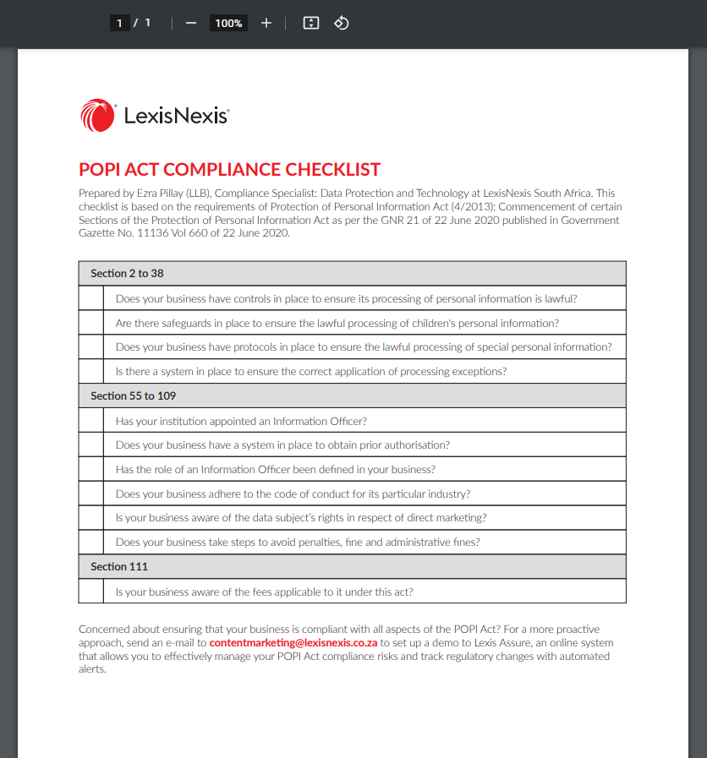
Training and support
Readiness Checklist
Notes:
Not applicable for this FIA audience.

Slide 19
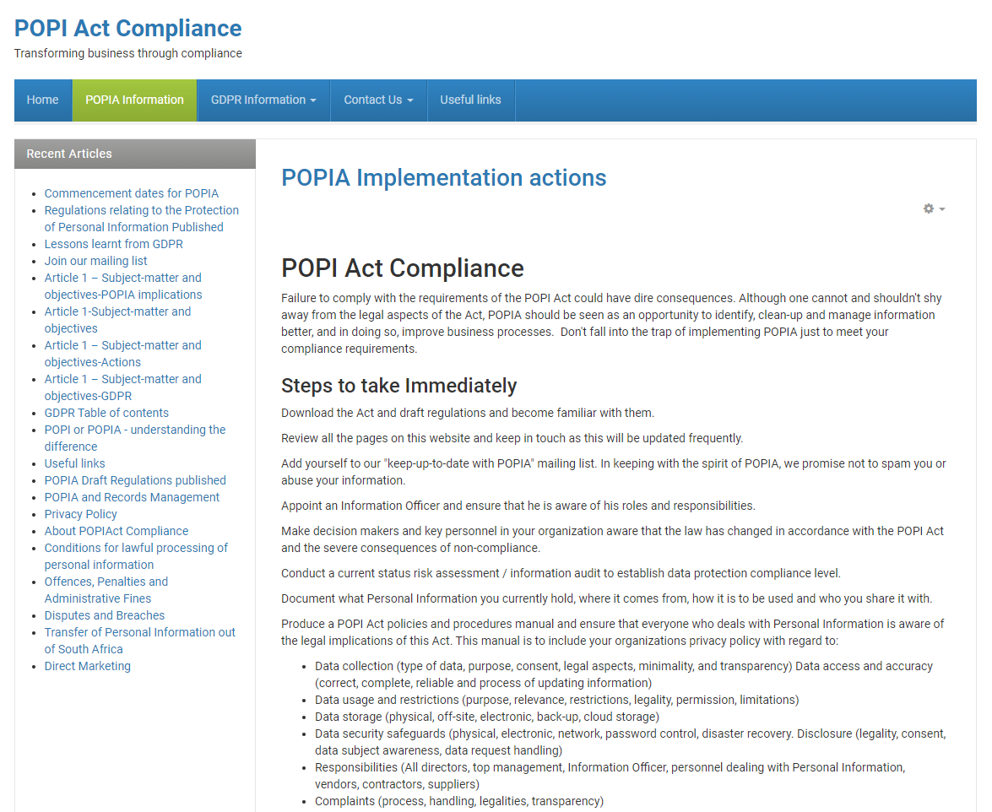
Training and support
Valuable information
Notes:
Not applicable for this FIA audience.

Slide 20
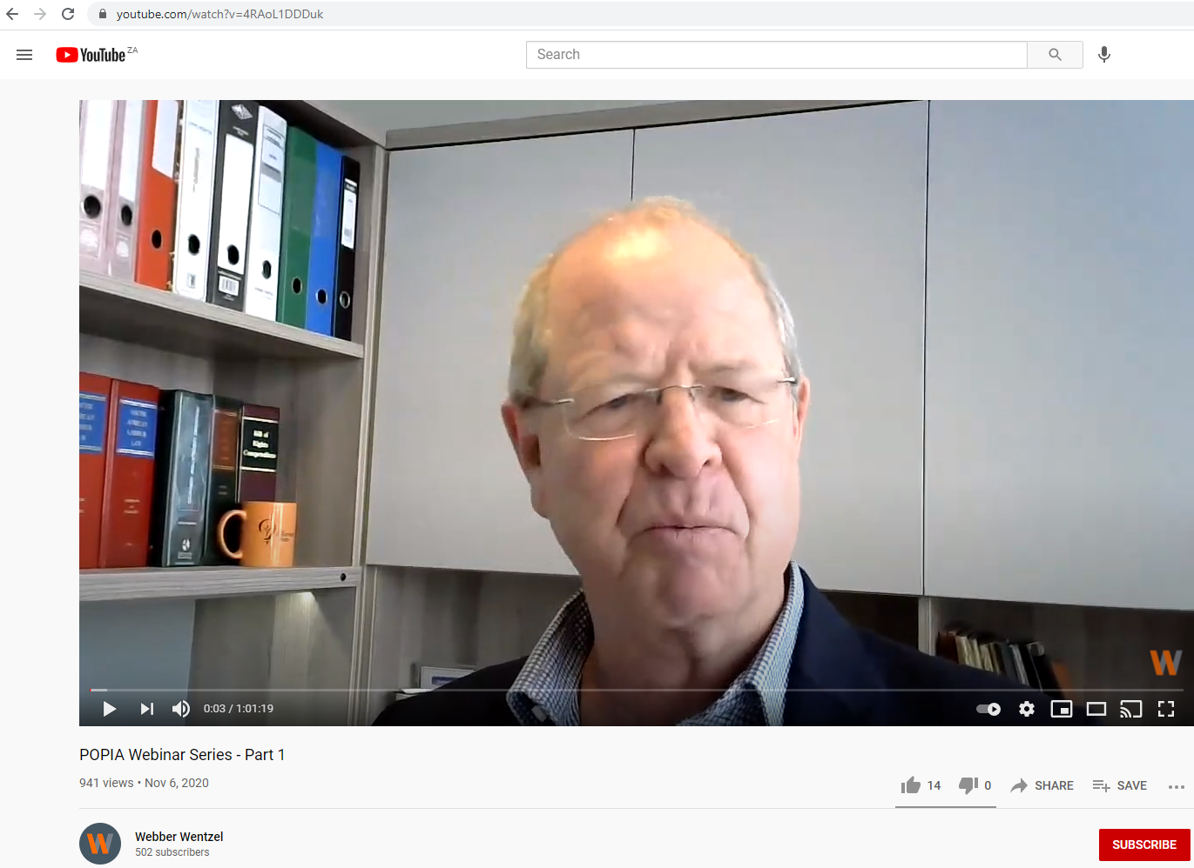
Training and support
Webinar 3 Part Webinar Series
(Webber Wentzel)
Notes:
Not applicable for this FIA audience.

Slide 21
Thank you
Question and Answer session next

